Slide 1
Western Hills Water District Water Rate Update
Board Meeting
November 4, 2015
HF&H Consultants, LLC

Slide 2
Agenda
Purpose of the meeting
Study Process & Background
Revenue Requirements
Cost of Service Analysis
Rate Structure Recommendation
Bill Impacts (current vs proposed rates)
Summary
Questions & Discussion

Slide 3
Purpose of the Meeting
Present revised rate alternatives based on feedback from September Town Hall meeting
Elicit input from rate payers and Board members
Authorize staff to draft and mail notices to rate payers

Slide 4
Study Process
Kickoff meeting – October 6, 2014
Preliminary analysis: Revenue requirements, cost of service analysis, rate design
Town Hall meeting – May 20, 2015
Received public input; developed additional alternatives
2nd Town Hall meeting – September 27, 2015
Received public input; developed additional alternatives
Board Meeting – November 4, 2015
Present rate alternatives
Board authorizes mailing notices to rate payers
Protest Hearing
At least 45 days after November 4 Board Meeting
Board adopts rates if no majority protest

Slide 5
Background
Ad Hoc Water Committee completed review of usage and cost data – February 2011
District adopted water rate increases – June 2011
 | FY 11-12 | FY 12-13 | FY 13-14 | FY 14-15 | FY15-16**
Treated – Residential
Service charge | $51.67 | $68.34 | $85.00 | $87.55 | $89.56
Usage charge $/750 gals | $1.25 | $1.25 | $1.25 | $1.29 | $1.32
Treated – Commercial
Service charge | None | None | None | None | None
Usage charge $/750 gals | $1.65 | $3.30 | $4.95 | $5.10 | $5.22
Raw Water
Service charge | None | None | None | None | None
Usage charge $/AF* | $1,075.00 | $1,275.00 | $1,475.00 | $1,519.25 | $1,554.19
* AF = 435.6 HCF = 325,851 gallons
** 2.3% CPI increase over FY 14-15

Slide 6
FY 2014-15 Rate Structure
Observations:
Industry standard: revenue from service charges should be ~30%.
Industry standard: all services should pay service charges.
Industry standard: service charges should be proportionate to size of connection.
Current rates do not allow for contributions to operating or capital reserves
Current revenue < cost of service.

Slide 7
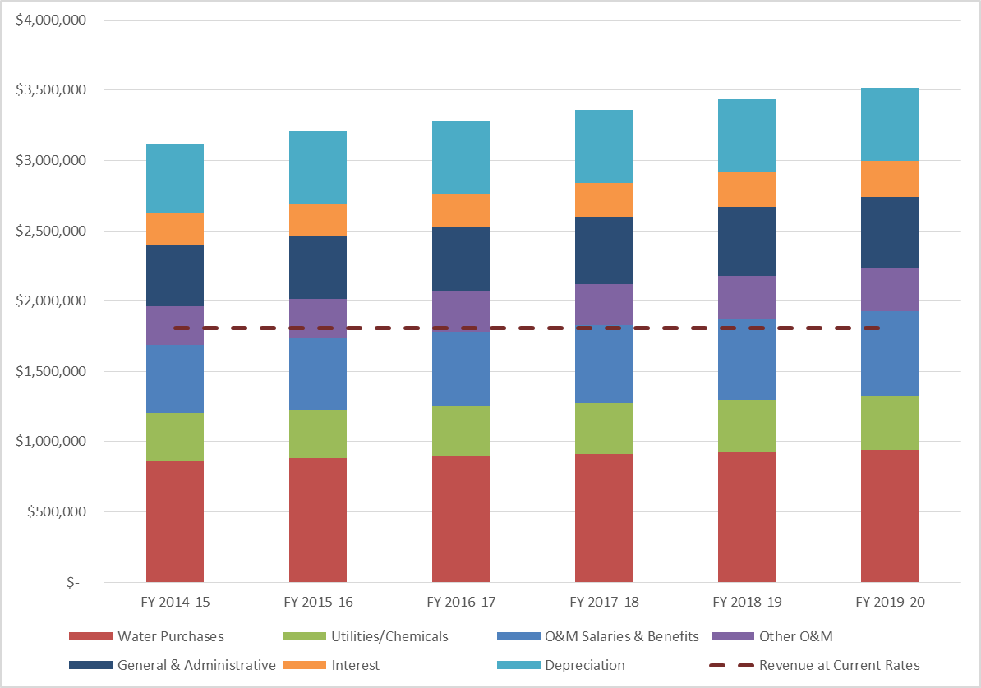
Projected Revenue Requirements

Slide 8
Cost of Service Analysis
Total Revenue Requirement allocated to customer classes based on their proportionate share of costs.
For example:
Water treatment costs allocated to residential and non-residential customer classes based on their percentage share of water used
Raw water customers are not allocated any water treatment costs
Pump station costs are allocated based on each customer classes share of water used (including raw water customers)

Slide 9
Cost of Service Allocation Summary
Current annual shortfall covered by Developer
Breakout of Residential $910k Revenue Shortfall

Slide 10
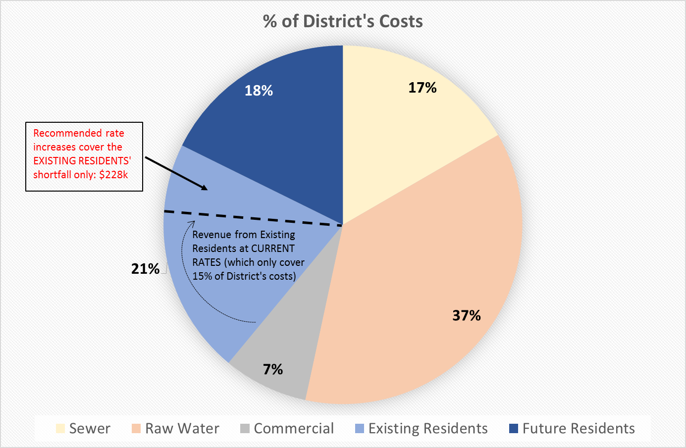
Cost of Service Allocation Summary

Slide 11
Bridging the $228k Gap
Alternatives discussed at the September Town Hall meeting, included:
Timing of revenue increases
Immediate or over 3-year period
With and without contributions to operating and capital reserves for existing infrastructure only; not for growth-related expenses

Slide 12
Bridging the $228k Gap
Revised alternatives include:
4-year phase-in period
Reserve contributions
45-day (six week) operating reserve
5-year annual average for capital projects
$46,000 annually for operations and capital
Capital reserves for existing infrastructure only; not for growth-related capital expenses

Slide 13
Revised Rate Alternatives
Alternative 1: Phase-in over 4-year period w/o contribution to Reserves
Fixed charges reduced from $89.56/mo to $62.00/mo by FY2018-19
Per-unit usage charges increase from $1.32 per hcf ($0.00176/gal.) to $7.53 per hcf ($0.01004/gal.) by FY2018-19
No contribution towards reserves during phase-in; revisit after phase-in period is complete
Alternative 2: Phase-in over 4-year period w/ contribution to Reserves
Fixed charges reduced from $89.56/mo to $62.00/mo by FY2018-19
Per-unit usage charges increase from $1.32 per hcf ($0.00176/gal.) to $8.19 per hcf ($0.01092/gal.) by FY2018-19
$46,000 annual contribution to reserves

Slide 14
Revised Rate Alternatives
Both alternatives:
Shifts revenue from the fixed service charge to the usage charges
Reduces fixed revenue from 80% to 40%
Increases usage revenue from 20% to 60%
Improves balance between rate payer equity and revenue stability
Requires the developer to contribute revenue so that current residents are not covering the costs of future customers (approx. $3M over the 4-year phase-in period)

Slide 15
Revised Rate Alternatives
 | Phase-in Rate Increases over a 4-year Period | Increased Revenue By Year 4
Alt. 1 – No Reserve Contribution | 10.3% per year | $228,000
Incremental Increase For Reserves | 1.5% per year | $46,000
Alt. 2 – With Reserve Contribution | 11.8% per year | $274,000

Slide 16
Rates and Sample Bills (Water Only): Alt. #1
No contribution to reserves
Reduced fixed service charge phased-in over 4 years
Usage rate increase phased-in over 4 years
Note: In addition, residents pay a monthly storm drain and sewer charge
Sewer = $55.79/mo
Storm Drain = $5.00/mo

Slide 17
Range of Bill Impacts: Alt #1
FY2015-16 average bill impacts
Bills vary month-to-month based on actual usage
52.4% of bills will see no more than a $5 increase
When any resident uses less than 3,150 gallons in a month, their bill will be less
Similar $/mo. Increases: effective July 1, 2016; July 1, 2017; and, July 1, 2018

Slide 18
Rates and Sample Bills (Water Only): Alt. #2
$46,000 annual contribution to reserves
Reduced fixed service charge phased-in over 4 years
Usage rate increase phased-in over 4 years
Note: In addition, residents pay a monthly storm drain and sewer charge
Sewer = $55.79/mo
Storm Drain = $5.00/mo

Slide 19
Range of Bill Impacts: Alt #2
FY2015-16 average bill impacts
Bills vary month-to-month based on actual usage
48.2% of bills will see no more than a $5 increase
When any resident uses less than 2,850 gallons in a month, their bill will be less
Similar $/mo. Increases: effective July 1, 2016; July 1, 2017; and, July 1, 2018

Slide 20
Summary
Current rate revenue is less than the cost of service.
Current rate structure does not reflect industry standards.
Service and usage charges could be aligned closer to cost structure
Rate structure modifications can be gradually made in conjunction with rate increases over a period of time.

Slide 21
QUESTIONS & DISCUSSION
HF&H Consultants, LLC
201 N. Civic Drive, Suite 230, Walnut Creek, CA 94596 925-977-6950
John Farnkopf | Rick Simonson
Senior Vice President | Vice President

